Slide 1


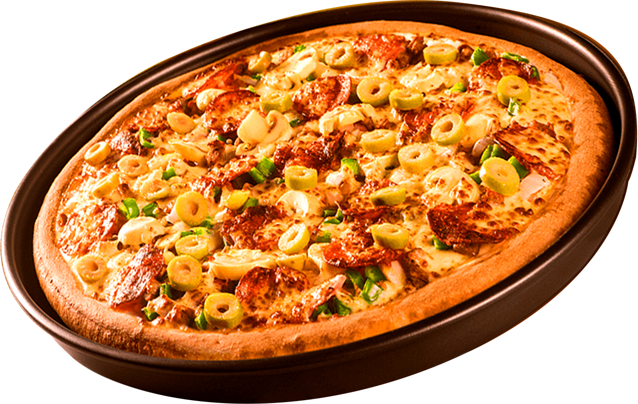
Where Every Slice is a Taste of Perfection
SQL PROJECT ON PIZZA SALES
ORDER
NOW
By: Harveen Kaur Sandhu

Slide 2
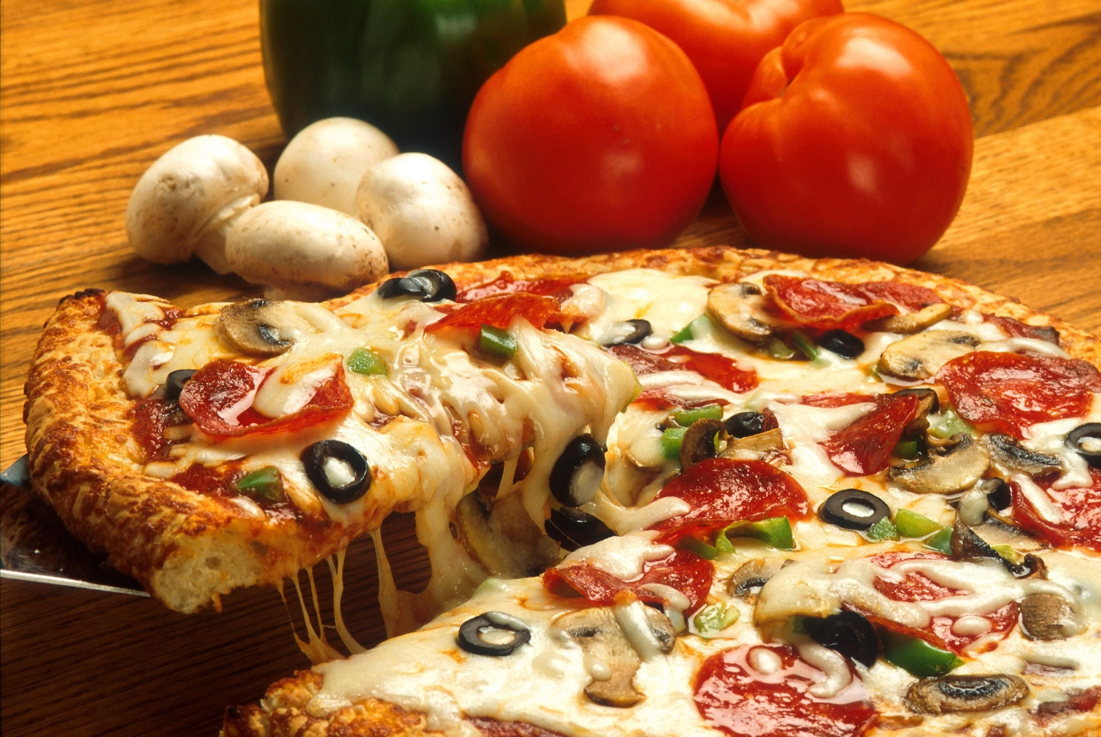
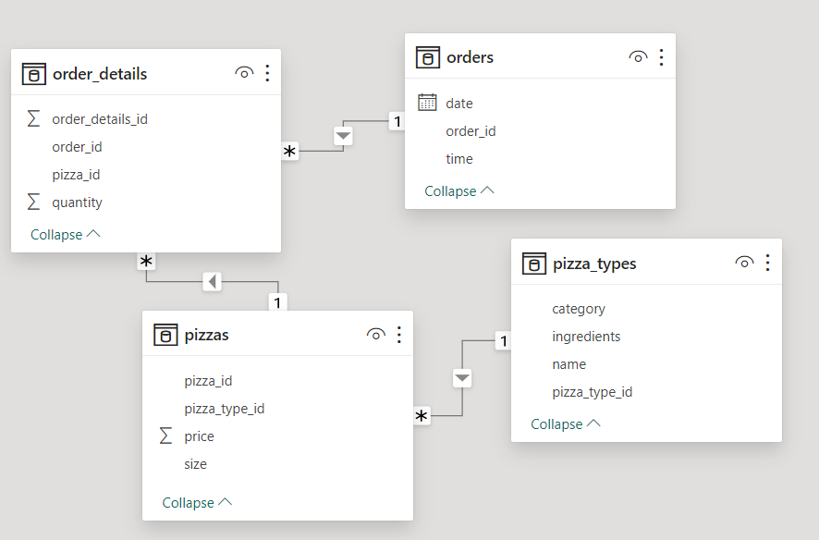
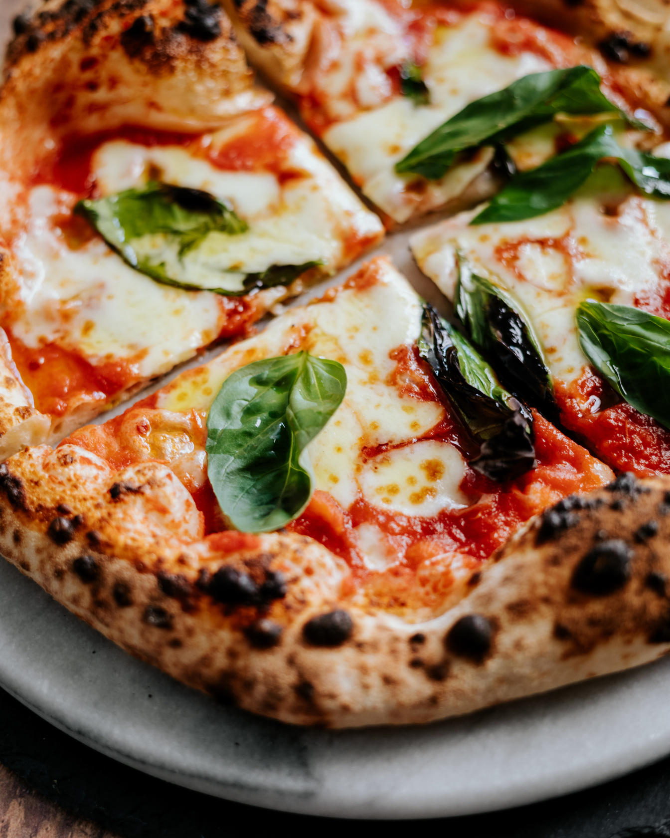
RELATION BETWEEN EVERY TABLES

Slide 3
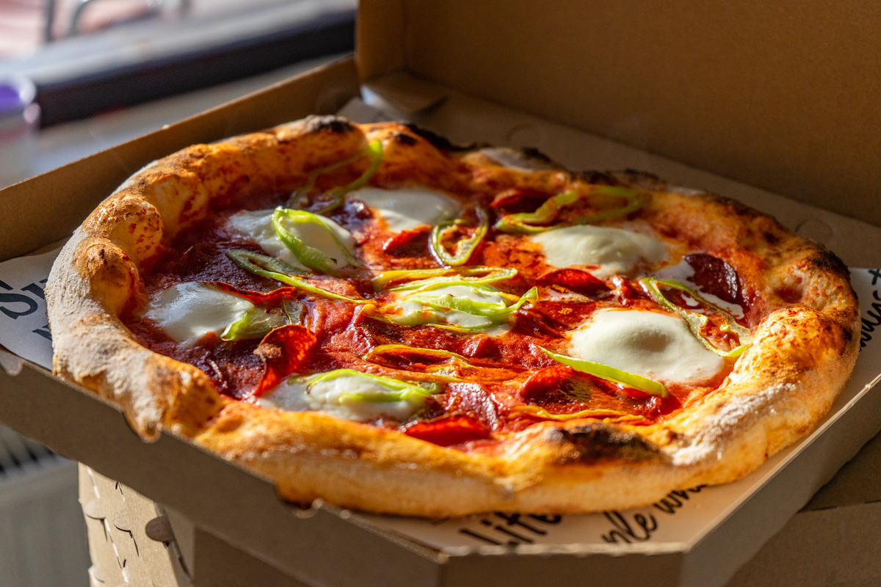
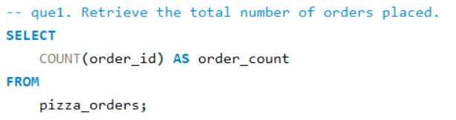
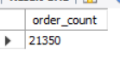
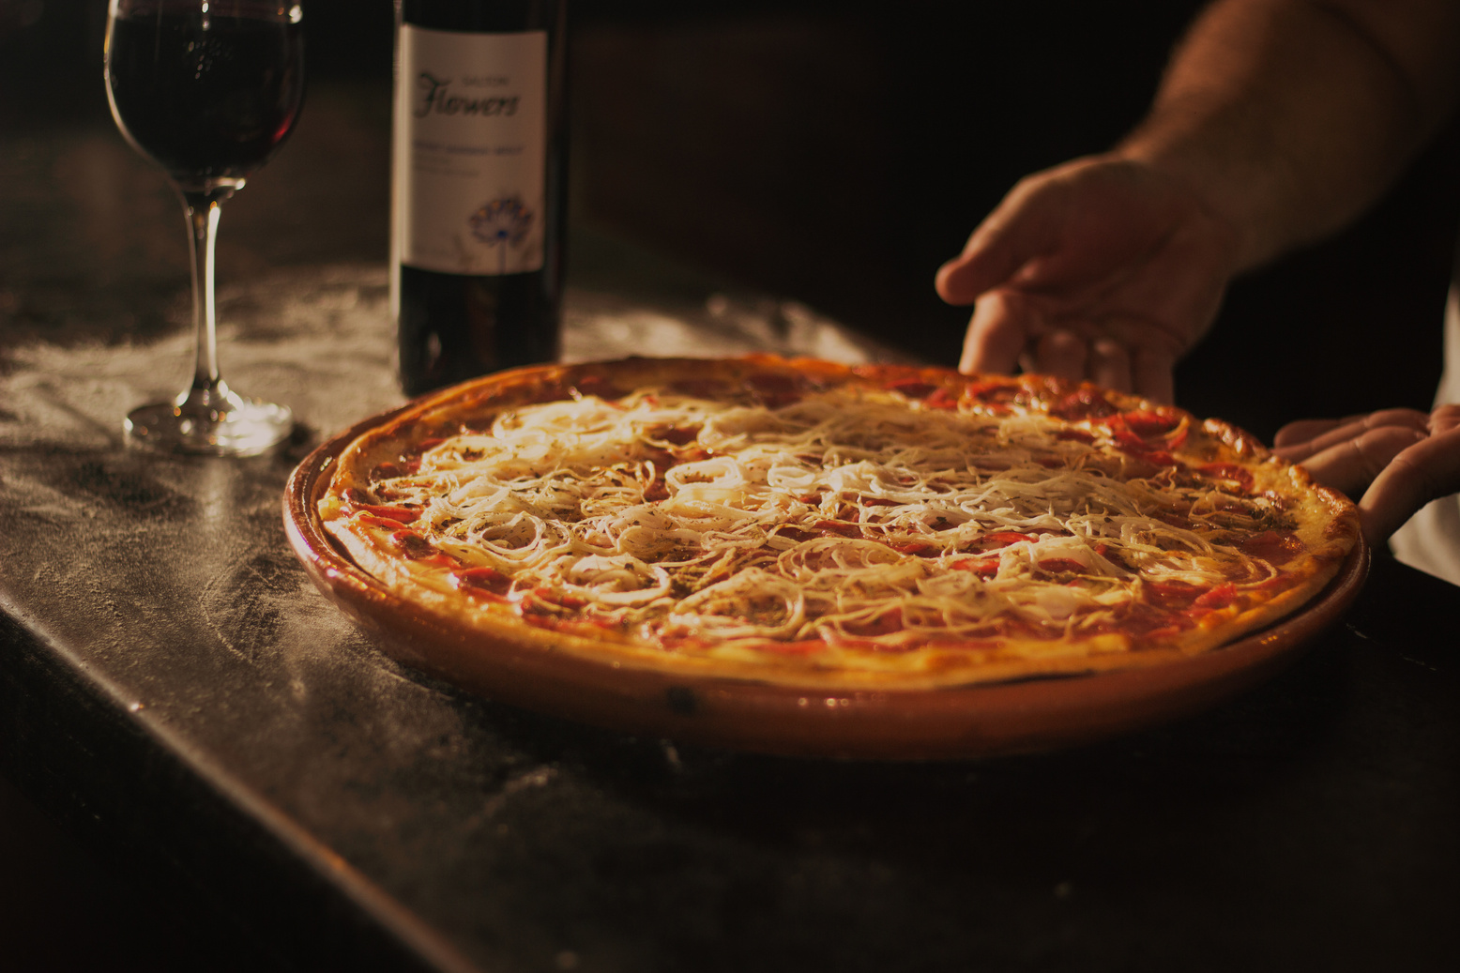
HOW MANY TOTAL NUMBER OF ORDERS ARE THERE ?

Slide 4
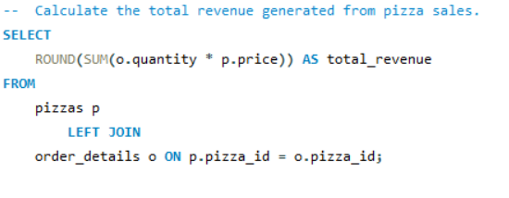
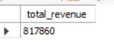
WHAT IS THE TOTAL REVENUE GENERATED?

Slide 5
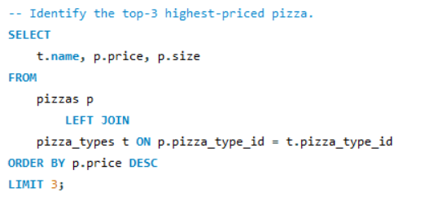
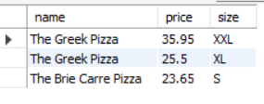
TOP 3 HIGHEST PRICE PIZZAS?

Slide 6
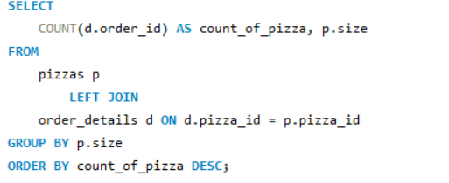
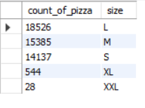
MOST COMMON PIZZAS SIZE ORDERED?

Slide 7
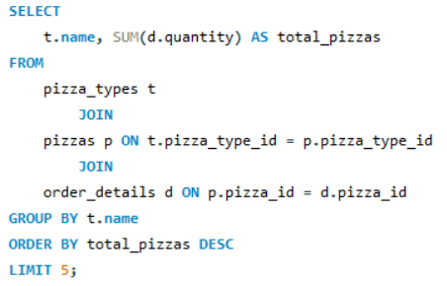
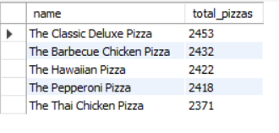
MOST ORDERED PIZZA TYPES ACC. TO QUANTITIES

Slide 8
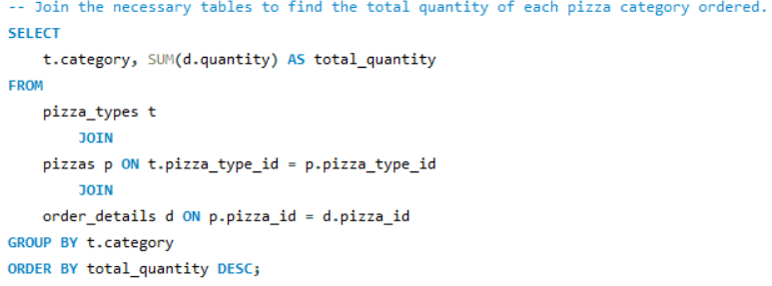
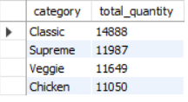
TOTAL NUMBER OF PIZZAS CATEGORY

Slide 9
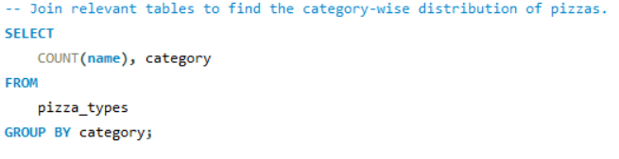
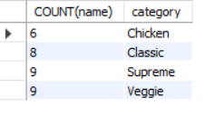
CATEGORY WISE DISTRIBUTION OF THE PIZZAS

Slide 10
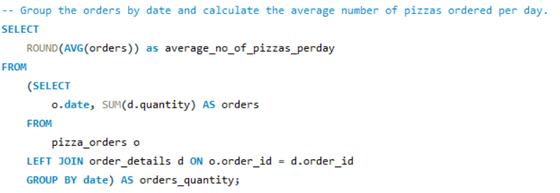
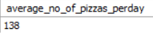
CALCULATE THE AVERAGE NO. OF PIZZAS PER DAY

Slide 11
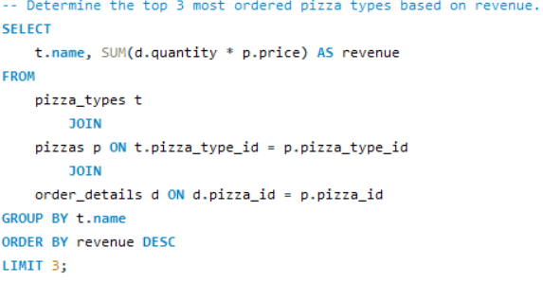
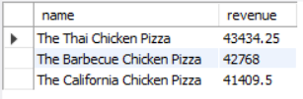
TOP 3 MOST ORDERED PIZZAS BY REVENUE

Slide 12
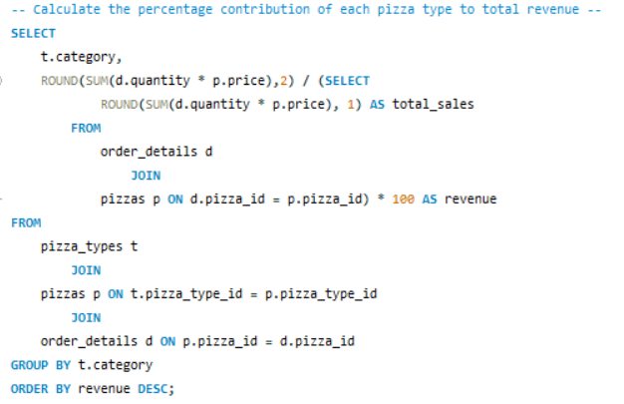
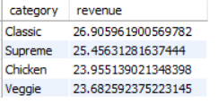
CALCULATE THE PERCENTAGE CONTRIBUTION OF EACH PIZZA TO TOTAL REVENUE

Slide 13
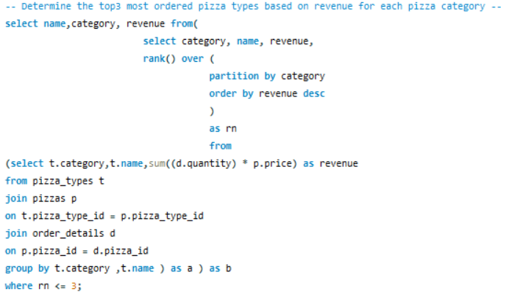
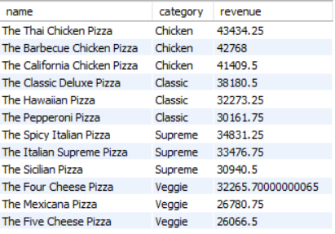
TOP 3 MOST ORDERED PIZZA NAMES BASED ON REVENUE FOR EACH PIZZA CATEGORY

Slide 14
THANK YOU

